Slide 1
HYBRID RECOMMENDATION SYSTEM
RITHWIK CHITHREDDY 18BLC1133
SHRENI AGRAWAL 18BLC1012
S. HARSHAAVARDHINI 18BLC1053

Slide 2
Identification of Problem Domain
The paper we chose proposed a hybrid recommendation system which is applied on two dimensional spaces (User × Item) with a large number of Users and a small number of Items.
It makes use of both favorite and non-favourite items of a particular user.
The proposed framework is built upon the integration of association rules mining and the content-based approach.
Apriori Algorithm was used for generating association rules.
Jaccard’s coefficient under content based approach used to find similarity between two items.

Slide 3
Design Methodology
We are proposing a Hybrid Recommendation system that uses both collaborative and content based approach.
We have taken dataset from MovieLens and preprocessed it.
The top movies from both the approaches are taken and recommend to user.
We divided the process into 4 modules.

Slide 4
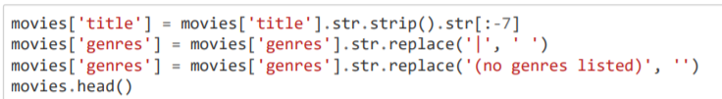
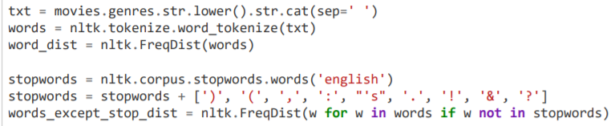
1) Data Preprocessing
Got rid of release year in movie titles for future title analysis and of timestamps in ratings.
Dataset is converted into more readable and accessible form.

Slide 5
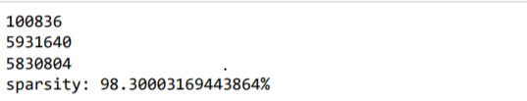
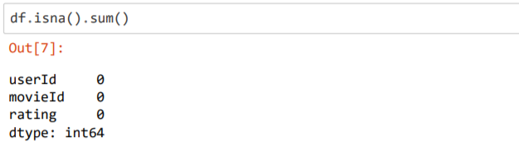
The sparsity of dataset is approximately 98%.
It is checked whether dataset contains any NA values.
Dataset divided into training and testing set.

Slide 6
2) Collaborative filtering
For training three columns are used : userid, movieid and ratings.
Then we created surprise dataset and used reader from surprise to scale the ratings.
Then training set and prediction set was formed.
Then the model was created using SVD (Singular Value Decomposition).
Then model was trained using five fold cross validation.
Predicted the ratings for all the pairs that are not in the Training set.
Then top three movies based on predictions is recommended to the users.

Slide 7
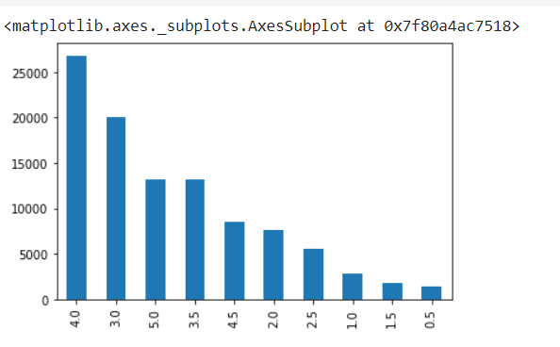
Visualization
Ratings count

Slide 8
3) Content Based Approach
For training we use a vector with its rating that the user has already watched and a movie matrix (movies vs a feature set). These two are used to get the weighted feature set for the movies.
We aggregate the weighted feature matrix and normalize them to form the user profile.
Now using this user profile and the movie matrix (of the movies not watched), we get the weighted movie matrix.
This matrix is aggregated to get the user’s interest level in those movies. A movie is recommended based on the highest interest level of the user.

Slide 9
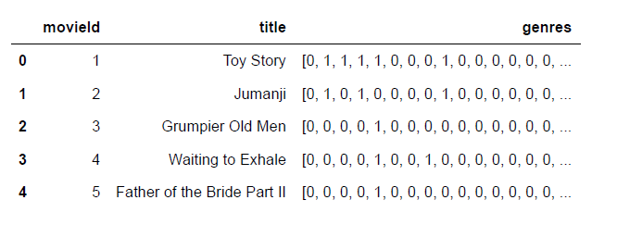
A vector of 21 values created for each movie to understand its genre.
A data frame made with its ID, title and genre.

Slide 10
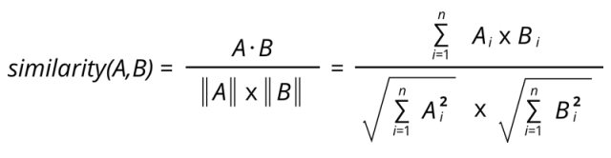

Function get_cossim to get a movie similar to another movie based on the genre.
Uses cosine similarity.

Slide 11

Function get_similar, for a given user, finds movies highly rated by user and find similar movies.
Uses get_cossim function
Function get_top is the driving function.
Uses get_similar (which uses get_cosim) to find the top n recommendations.

Slide 12
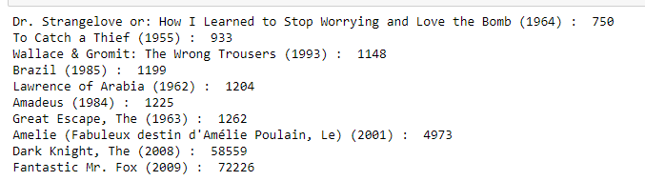
4) Hybrid Recommendation System
The movie is recommended to a particular person is taken from both the systems.
Then the top n movie Ids from both systems is appended to a list.
Since we are combining two advanced recommendation systems, the accuracy of the hybrid system is expected to improve.

Slide 13
THANK YOU

